Slide 1

Machine Learning(CS-7830-01)
~By Tanvi Banerjee.
Team-9
Plant Disease Detection using Fuzzy KNN and MLP -2023
Members of the project
Kartheek Kodati – U01033252 Sneha Mirupala – U01033363 Tejaswini Minupala - U01066894

Slide 2
Table Of Content
Abstract
Introduction
Methodology
Explanation Of Methodology
Bar Graph
Input & Output
Validation Methods
Conclusion

Slide 3
Abstract
Plant diseases can have a major impact on agricultural communities worldwide, leading to economic losses and food security issues.
Machine learning algorithms such as Fuzzy K-Nearest Neighbor and Multi-Layer Perceptron(MLP) show promise in automating plant disease detection and classification.
The proposed plant disease classification system includes several steps, including data collection, preprocessing, feature extraction and selection, model training and testing.
Using preprocessing techniques, feature extraction and selection, and machine learning algorithms shows high classification accuracy is achieved in plant disease detection and identification so that we can prevent spreading diseases and minimize the crop damage.

Slide 4
Introduction
Using the image processing technique for plant disease detection we can achieve less damage in the agriculture fields.
By using Fuzzy KNN we have divided the dataset into number of different healthy/diseased leaf clusters with degree of membership of each node.
We have developed a class to score the accuracy, for the similar cluster of the diseased leaf’s of the plant.
Multilayer Perceptron(MLP) preprocess the data in the node-1 then it will go through hidden layer and process the trail and error form finally, the final layer is able to predict name the disease of a leaf with the input leaf.

Slide 5
Methodology
Datasets
Data Preprocessing and feature extraction
Feature selection
Modeling
Fuzzy K-Nearest Neighbor
MLP(Multi-layer Perceptron )

Slide 6
Dataset
Plant Village is a publicly available dataset that contains 54,306 images of 38 different healthy/diseased leaves related to their 14 plant species.
All of the deep learning models were trained on this dataset .The images were resized to 224 *224* 3 pixels in size, and normalization was considered by dividing the pixel values by 255 to make them more suitable for the initial values of the models, which was done by dividing the pixel values by 255.
To avoid overfitting, the dataset was divided into three categories: Training datasets, validation datasets, and testing datasets, which were divided by 70 percent, 20 percent, and 10 percent, respectively.

Slide 7
Data Preprocessing and Feature Selection
Data Preprocessing :Prior to the extraction of features, some background noise is removed in order to obtain more precise results.
The image is smoothed using a Gaussian filter after it has been converted from RGB to gray-scale. The image is first converted to the HSV color space in order to determine the amount of green color present in the image.
Feature selection : We are selecting features based on the correlation between various variables and the target variable. The correlation between the feature green part of leaf (F1) and the feature green part of leaf (F2) is extremely high, indicating that both variables are highly dependent on one another. As a result, we can eliminate F2.

Slide 8
Fuzzy KNN
Using the Fuzzy KNN the dataset will divide into number of different leaf’s(healthy/diseased) into different classes with a degree.
Firstly, In the given dataset, the method fit() is used to train the data into two classifications that is healthy/diseased.
We used method getDistance() to calculate the distance between one node to other node using euclidean distance.
We used fuzzy() method to give the degree of membership to each leaf.
The predict() method will classify the leaf’s according to their diseases.
Finally, we used score() method to score the accuracy of the classified cluster.

Slide 9
Multilayer Perceptron(MLP)
The MLP takes the extracted features of plant images as input and learns to classify the images into different disease categories.
MLP has 3 layers they are input layer, hidden layer and output layer
The input layer has a number of nodes equal to the number of features extracted from the plant images.
The hidden layer has a variable number of nodes, which are determined by trial and error or by using a grid search approach to find the optimal number of nodes.
The output layer has a number of nodes equal to the number of disease classes to be classified. The MLP also uses a backpropagation algorithm to adjust the weights of the connections between the neurons during the training process to get the better results.

Slide 10
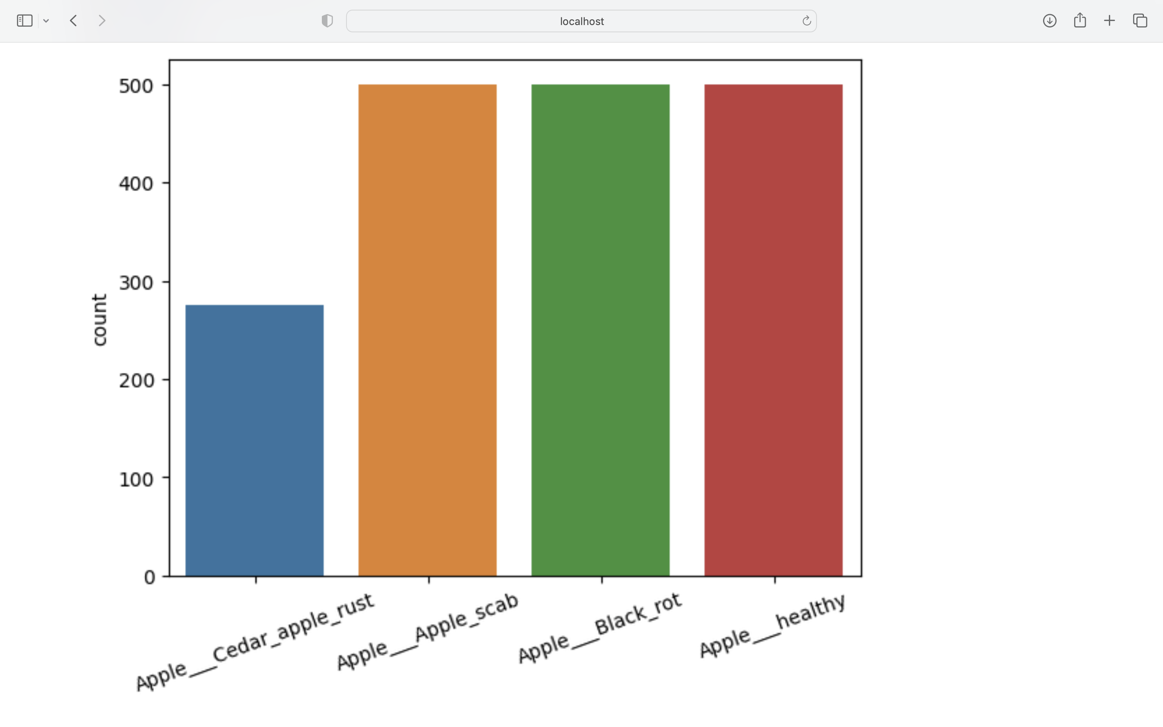
Bar Graph for the count of the images in the dataset

Slide 11
Flow chat of the program
START
Trial & error process
Output
Disease name on the leaf
Dataset
MLP
Fit()
END
Leaf Image
Training
getDistance()
Input
Calculate distance
Score the accuracy value
Fuzzy()
Score()
Give degree of membership
Predict()
Predict the class

Slide 12
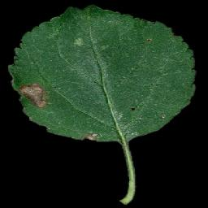
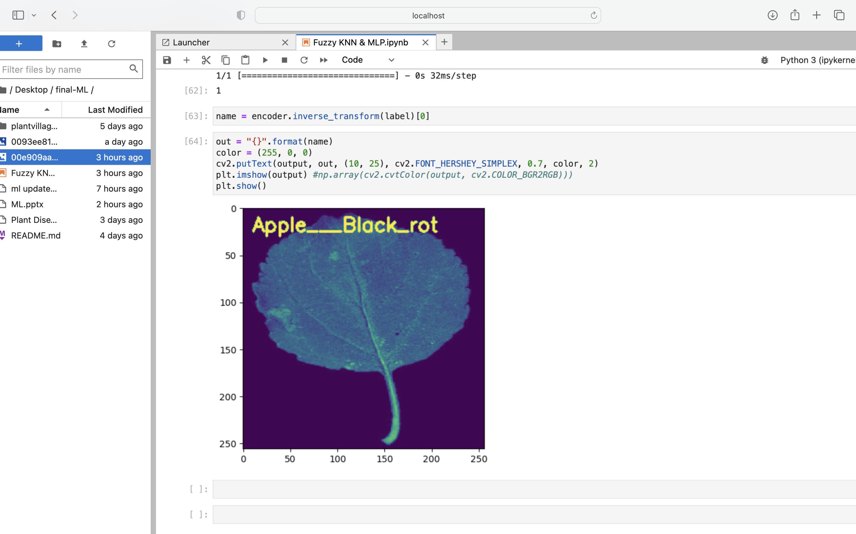
Input & Output
Sample
Input
Output

Slide 13
Validation Methods
Accuracy: Accuracy is the most intuitive performance metric, and it is simply the ratio of correctly predicted observations to the total number of observed observations (or observations correctly predicted).
Precision : The precision of a prediction is defined as the ratio of correctly predicted positive observations to the total number of correctly predicted positive observations.
Precision = True positive
True Positive + False Positive

Slide 14
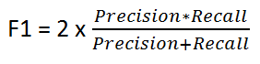
Validation Methods
Recall(sensitivity): The recall of positive observations is the ratio of correctly predicted positive observations to all positive observations in the actual class.
Recall = True positive
True Positive + False Negative
F1 Score: Precision and recall are combined to form the F1 Score, which is a weighted average. As a result, both false positives and false negatives are taken into consideration when computing this score.

Slide 15
Conclusion
Fuzzy KNN and MLP have been investigated in this project in order to better understand plant diseases. We have discuss the importance of collecting large datasets with high variability, data augmentation, and improving classification accuracy, as well as the importance of small sample plant leaf disease detection, and the importance of hyperspectral imaging for early detection of plant disease.
The Model has performed admirably, with an accuracy rate of 71 percent. We can experiment with different parameters to see which ones produce the best accuracy and score for the given situation.

